Slide 1
Team Sask CWG Trials Day 1
Team Captains Meeting

Slide 2
Start Lists
Paper Copies printed off for Clubs
Posted on Board
Published on crosscountrysask.ca ->Events ->Canada Winter Games
Sprint Prologue
High Seeds start first
Distance Interval Start
High Seeds start last
30 second intervals

Slide 3
Weather

Slide 4
Schedule – Saturday, December 30th
9:00 Cosmo Lodge Opens
9:00 Sprint and Distance Courses Marked and Open
9:30 Team Captains Meeting in Cosmo Lodge
10:45 Sprint Course Closes
10:45 Sit Ski Sprint Starts
11:00 Women’s 1250m Free Sprint Prologue (30 sec interval start)
11:10 Men’s 1250m Free Sprint Prologue (30 sec interval start)
11:30 Sit Ski 3km Mass Start

Slide 5
…continued Schedule – Saturday, December 30th
12:00 – Distance Course Open
13:20 – Distance Course Closes
13:30 – Women’s 4.5km Free Interval Start (30 sec intervals)
14:00 – Men’s 9km Free Interval Start (30 sec intervals)
15:00 – Team Sask Uniform Sizing and Head Shots in Cosmo Lodge
15:30 – CWG Trials Wrap Up and CWG Info Meeting in Cosmo Lodge

Slide 6
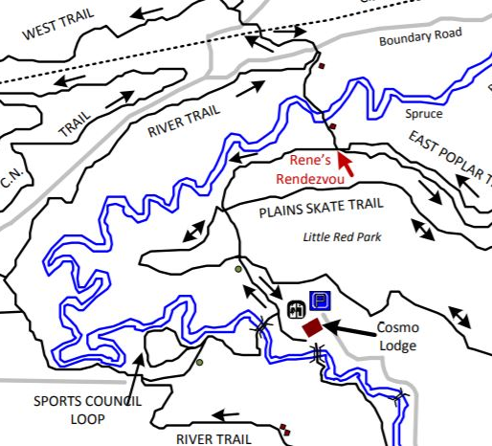
Warm Up/Cool Down
AM
Sprint Course Closes at 10:45
PM
Distance Course Closes at 13:20

Slide 7
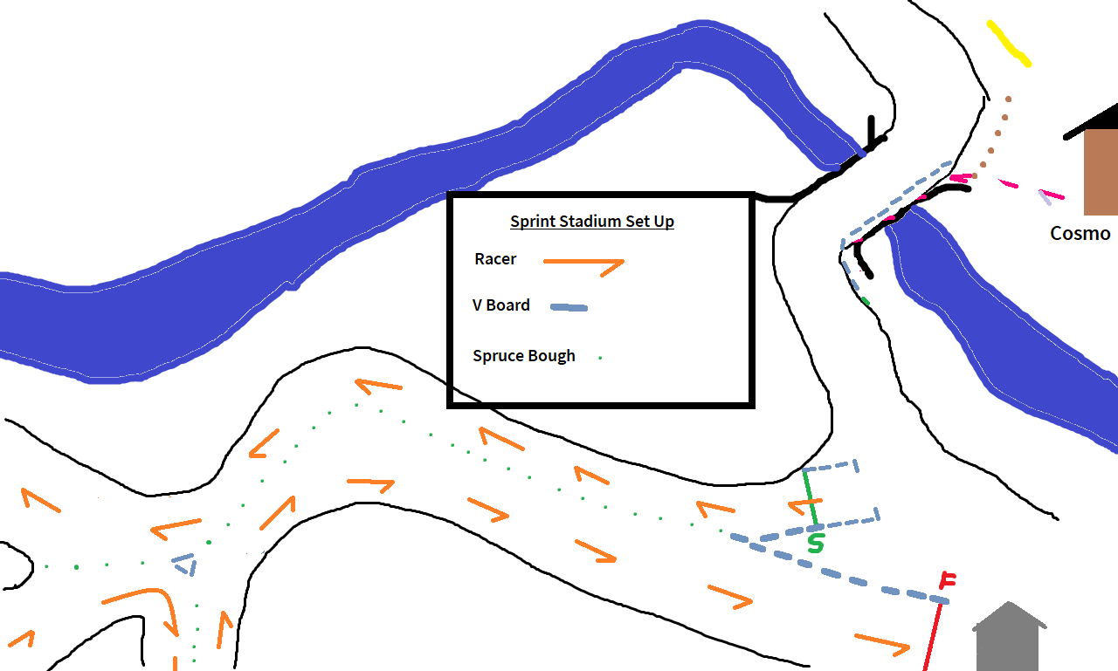
Sprint Stadium

Slide 8
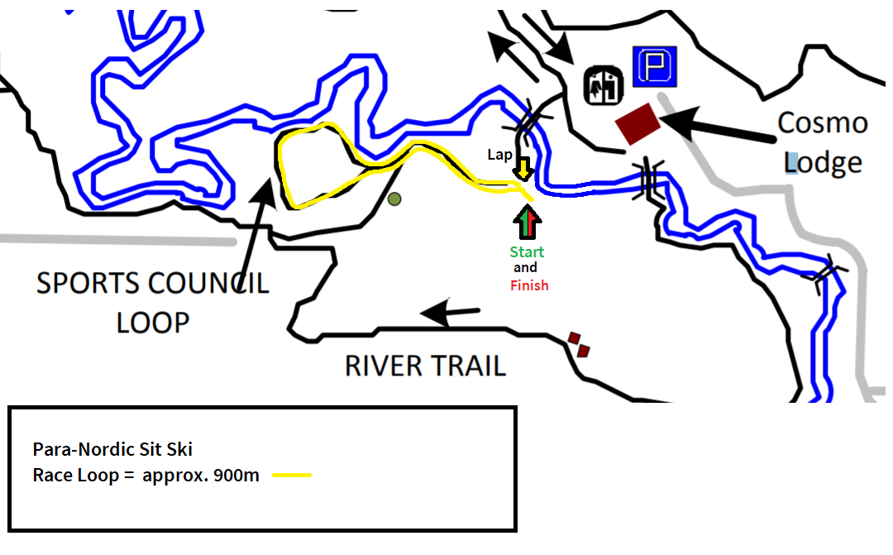
Sit Ski Course

Slide 9
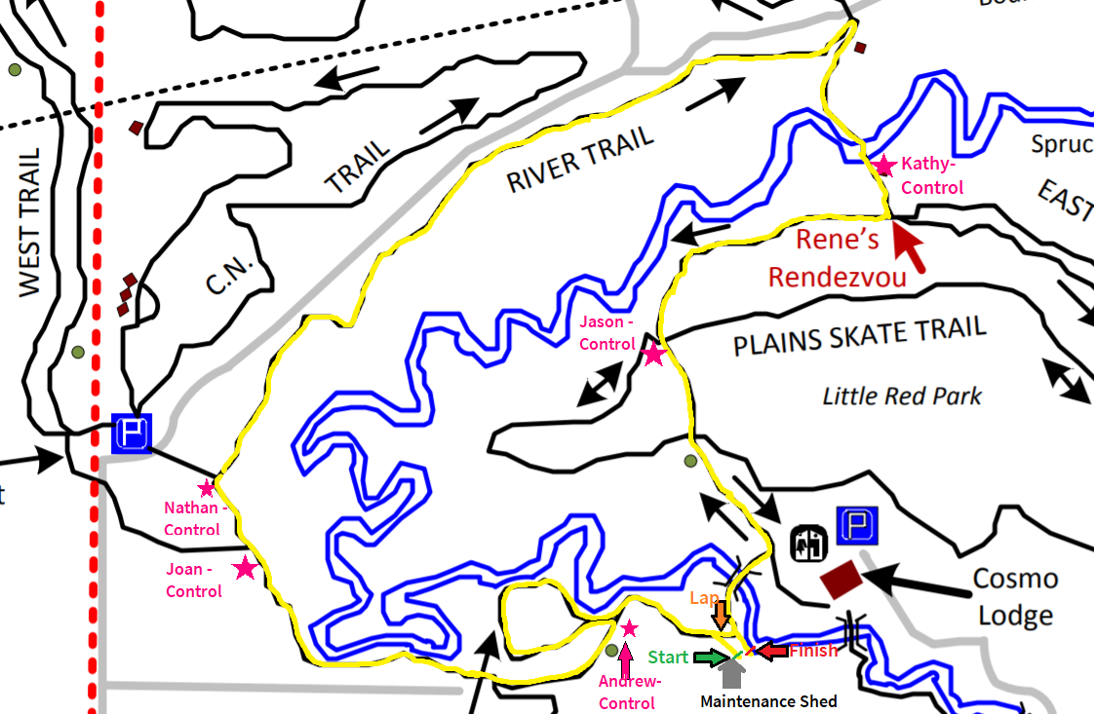
Free Technique Distance Course

Slide 10
Comments from TD

Slide 11
Bib Pick Up
AM – Sprints -> Now
PM – Distance -> 11:30 – 12:00

Slide 12
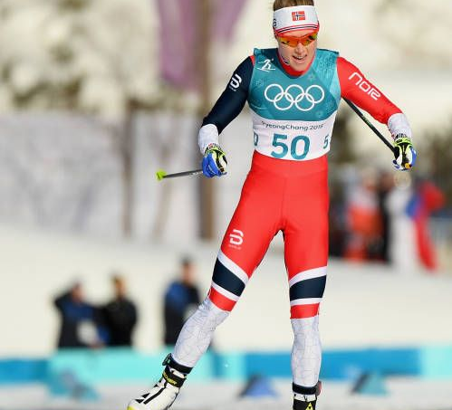
CWG Trials Wrap Up Meeting
15:30
RIGHT HERE
Unofficial CWG Trials Rankings will be posted
Information on up coming events, Games, Uniforms, etc
GOOD LUCK TODAY!

